Slide 1

Enclave and TEE
Computer System Engineering, Fall 2019. (IPADS, SJTU)
Trusted Execution Environment
Yubin Xia

Slide 2
Is Hypervisor Secure?

Slide 3
Hypervisor is Getting Bigger
Control VM
Tools
Guest
VM
Kernel
VMM
Trusted Computing Base
The TCB contains virtualization stack
The TCB size is larger than 9 Million LOCs

Slide 4
Hypervisor is Getting Bigger
One point of penetration leads to full compromise
The virtualization stack should not be trusted
Notes:
Unfortunately, it does grow. Here we show the number of security issues of Xen and Vmware ESX from CVE.
We can see that the number is growing year by year.
In 2012, there're 39 new security issues found in Xen.
Since in virtualization stack, “one point of …”, we claim that “the virtualization stack …”

Slide 5
Hypervisors have Bugs
Xen is used by Amazon EC2
Xen's CVE is growing
  210 XSA (Xen Security Advisories)
  Xen's LoC is growing from
  45K (v2.0) to 270K (v4.0)
  KVM also has 100+ CVEs
Data from https://xenbits.xen.org/xsa/

Slide 6
Analyze 201 of Xen's Vulnerabilities (XSA)
191
144 (75% of 191)
47
10
144 are in the hypervisor
  E.g., Host DoS, privilege
  escalation, etc.
  Use hypervisor to attack VM
47 are not in hypervisor
  Some are in Domain-0
  Some are in Qemu
10 are ignored
  7 numbers are not used
  XSA-161 was withdrawn
  XSA-99 is irrelevant
  XSA-166 is too vague
Focus on this part

Slide 7






3 Dimensions to Categorize (144 Hypervisor bugs)
Which component to attack?
How to attack?
Attack for what?
Hypervisor
Hypervisor
Hypervisor
Attack targets
Memory management: 25.7%
CPU virtualization: 21.5%
Code emulation: 13.2%
...
Key steps of attack
Memory corruption: 45.1%
Misuse of hardware: 22.2%
Live lock: 8.3%
...
Results of attack
Host DoS: 61.8%
Privilege escalation: 15.3%
Info leak: 13.9%
...

Slide 8
1. Xen Components with Bugs
25.69%
21.53%
13.19%
Components with bugs
  25.69%: Memory management
  21.53%: CPU virtualization
  13.19%: Code emulation
Observations:
  Some components are more attractive to attackers
  Memory management is critical and hard to get right

Slide 9
2. The Types of Key Step of Attack
45.1%
22.2%
Memory corruption: 45.14%
  Illegal memory read
    E.g., out-of-boundary
  Illegal memory write
    E.g., write to an invalid pointer

Slide 10
3. The Consequences of Attack
61.8%
15.3%
Host DoS: more than 60%
  All DoS: more than 70%
Guest to guest attack
  Some guest app leverages hypervisor to DoS its own guest VM
13.9%

Slide 11
Observations
Hypervisors have bugs
  Some previous studies focused on bugs of dom-0 or host OS
  Some systems (e.g., nested virtualization) can solve the problem but may cause performance overhead due to nested levels
Some components have more vulnerabilities (found)
  Take consideration on mem management, code emulation, etc.
DoS cannot be ignored
  Need to tolerant DoS for availability

Slide 12
Nested Virtualization

Slide 13
Goal of CloudVisor
Defend again curious or malicious cloud operators
  To ensure privacy and integrity of a user VM
Be transparent to existing cloud infrastructure
  No or little modifications to virtualization stack (OS, Hypervisor)
Minimized TCB
  Easy to verify correctness (e.g., formal verification)
Non-goals
  DOS, Side-channel attacks, Semantic attacks to VM services from network
Notes:
Awaring of these problems, the goal of cloudvisor is to ...

Slide 14


Virtualization Preliminary: VT-x
VM
Ring 3
Ring 0
guest mode
VM entry
VM exit
host mode
Hypervisor
Notes:
Besides traditional privilege rings on the processor, VT-x introduced a new host mode.
Hypervisor is designed to run in host mode. All privileged operations in guest mode would cause trap into host mode, ie, Vmexit.

Slide 15
Interposition with CloudVisor
VM
Ring 3
Hypervisor
Ring 0
guest mode
VM entry
VM exit
VM entry
VM exit
host mode
Cloudvisor
Notes:
Cloudvisor interposes hypervisor and vms...
In this way, some sensitive states (general purposed registers) could be saved during VMExit.

Slide 16
VM Memory Isolation
Goal: forbid hypervisor access to VM memory
Rules:
  When a page is assigned to a VM, CloudVisor changes the ownership of the page
  A memory page is only accessible to its owner
Notes:
By leveraging this privileged position, cloudvisor conducts memory isolation by hardware assistance.
The goal of memory isolation is to forbid ...
Cloudvisor also provide strong memory isolation among the hypervisor and guest vms.

Slide 17
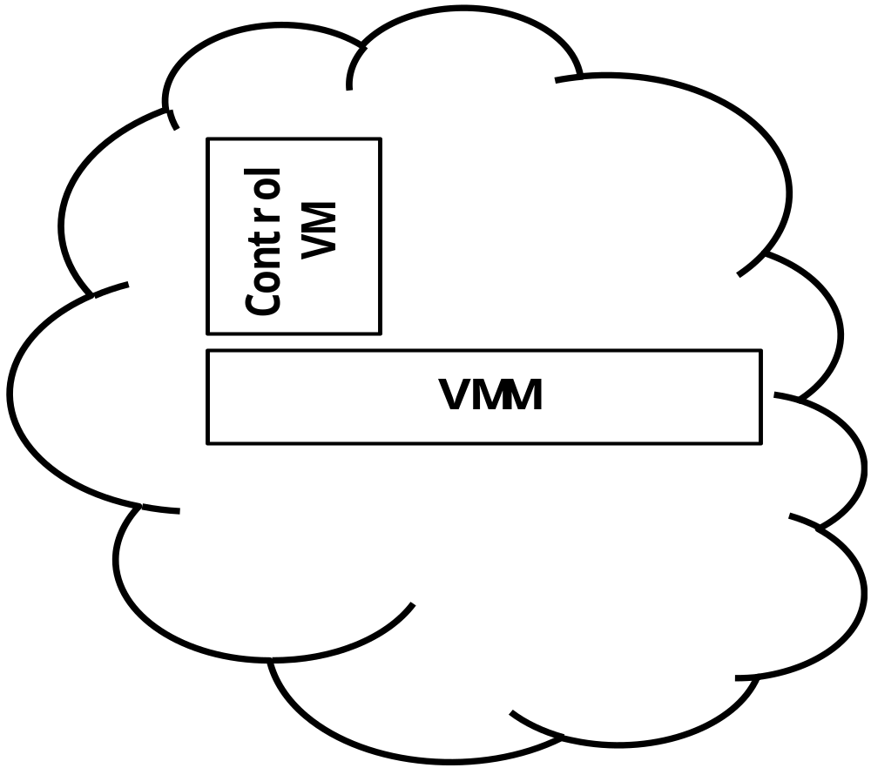
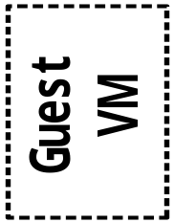
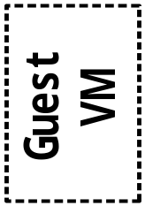
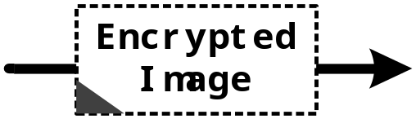

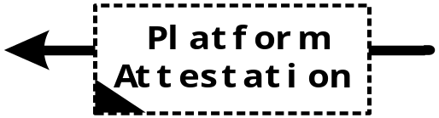
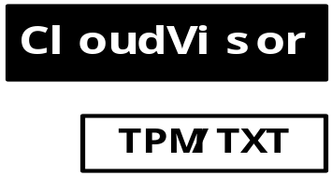
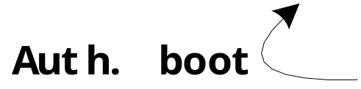
Architecture (logically) of CloudVisor

Slide 18
Nexen: Deconstructing Xen
Dom-0
Para-VM
Full-VM
Virtual Machine
Hypervisor
Xen Slice
Xen Slice
Xen Slice
Shared Service
Security Monitor
Partition Xen into several internal domains, all the domains run in the same hardware privilege

Slide 19
Xen Slice
Dom-0
Para-VM
Full-VM
Virtual Machine
Hypervisor
Xen Slice
Xen Slice
Xen Slice
Shared Service
Same code,
Different instances
Security Monitor
Each Xen slice serves only one VM, containing the VM's metadata and handling its VMExits

Slide 20
Shared Service
Dom-0
Para-VM
Full-VM
Virtual Machine
Hypervisor
Xen Slice
Xen Slice
Xen Slice
Shared Service
Serve all
the Xen slices
Security Monitor
Only one shared service. It does not interact directly with VM, just serves Xen slices.

Slide 21
Security Monitor: Controls the MMU
Isolation
Dom-0
Para-VM
Full-VM
Virtual Machine
Hypervisor
Xen Slice
Xen Slice
Xen Slice
Shared Service
Security Monitor
The security monitor controls guest page tables and EPTs. It offers interfaces & does security checks.

Slide 22
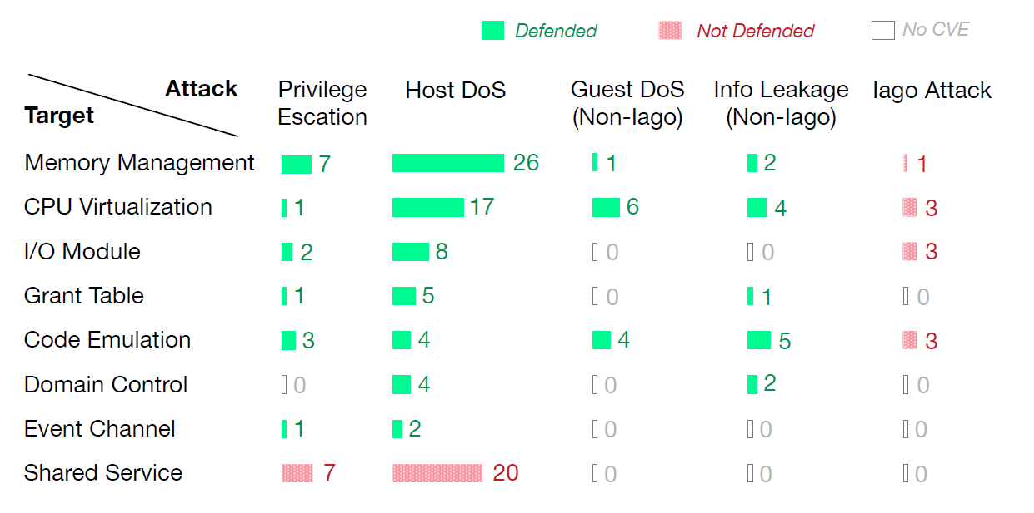
Security Evaluation on 144 XSAs
10/144 (7%): attack through
interface, depends on semantic
107/144 (74%): Defended
27/144 (19%): target the shared service and can cause host failure

Slide 23
Case Study: XSA-108
VM
VM
Type: Out-of-boundary mem access in
code emulation causes info leak
Description
  Xen's code emulation for APIC erroneously emulates read and write permissions for 1024 MSRs where there are actually 256 MSRs. A read operation can go beyond the page set up and potentially get sensitive data from the hypervisor or other VMs
Xen Slice
Xen Slice
Security Monitor
- case MSR_IA32_APICBASE_MSR ... MSR_IA32_APICBASE_MSR + 0x3ff: + case MSR_IA32_APICBASE_MSR ... MSR_IA32_APICBASE_MSR + 0xff:

Slide 24
Enclave and TEE
Trusted Execution Environment

Slide 25
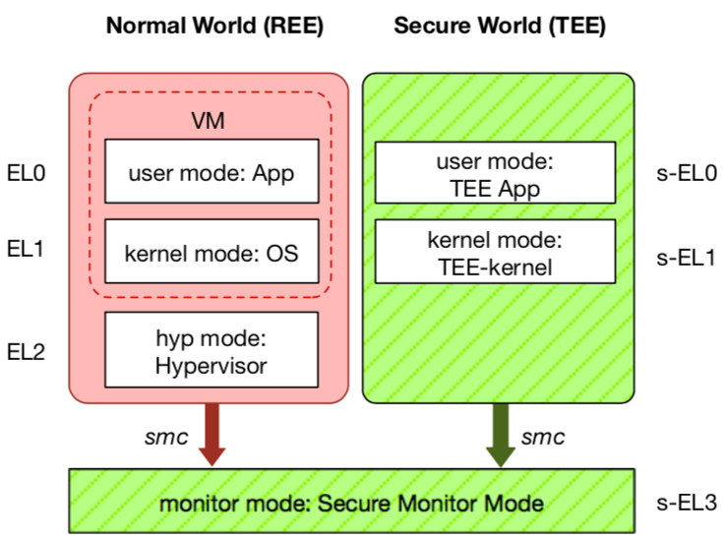
ARM TrustZone: TEE on Mobile Devices
Widely deployed on mobile devices
  Every Android device must deploy TEE
  Mostly based on ARM TrustZone
An isolated & privileged environment
  TEE can access all DRAM & peripherals
  REE cannot access TEE's resources
Designed to be secured and small
  For security-critical tasks (e.g., fingerprint
  checker, mobile payment, etc.)
Notes:
Before presenting virtualization of TEE, let me introduce TEE a little bit.
TEE is short for xxx. It has been widely deployed on mobile devices. Thanks to Google, now every Android phone needs to have TEE to pass Google's test.
On mobile phone, most TEE are based on ARM TrustZone.
TrustZone divides one system to two worlds: xxx and xxx.
The normal world, aka REE, runs rich OS like Android or iOS. It has three layers: one for hypervisor, one for kernel and one for application.
The secure world, aka TEE, has three layers: one for TEE OS and one for TEE applications.
There is a special layer, called monitor mode or s-EL3, is used for switching between the two worlds. It is also part of the secure world but share the same privilege with s-EL1.
The switching is done through smc instruction.
The green part is TEE, which is an isolated environment with higher privileged than the REE.
It means that xxx
The TEE is designed to xxx, its typical usage is xxx.

Slide 26
ARM TrustZone
Trust Application Layer: Trustlets
Secure world
  Running TEE
  Has different privilege
Normal world
  Running REE (Rich Execution
  Environment)
  E.g., Android
However, the data in memory is still in plaintext
  Can we use encrypted data in memory without decryption?
T-IDS
T-Proxy
T-PIN
T-UI
T-FIDO
Middle Layer
TEE
Secure Services
Secure Libraries
Secure Runtime
Kernel Layer
Secure Channel
Secure Drivers
T-Visor
Trusted OS
Inside TEE

Slide 27
History of Memory Encryption
AMD SME
Bastion
HyperCoffer
XOM
XOMOS
AEGIS
AISE-BMT
SecureME
Intel SGX
2000
2003
2007
2010
2011
2013
2016
2017
Counter-mode encryption
Merkle-tree based integrity check

Slide 28
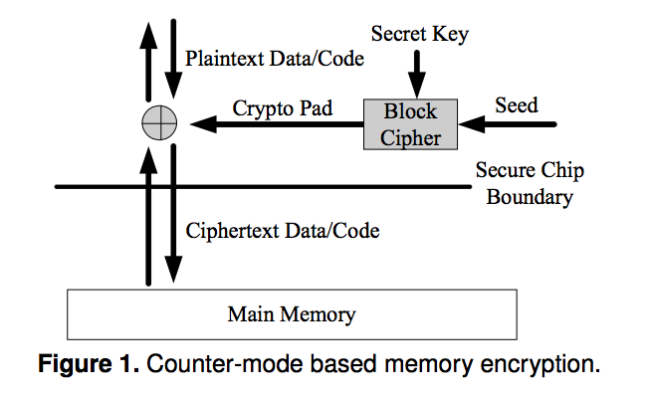
Counter-Mode Encryption
Security: Pad is unique
Approaches:
global counter
block address

Slide 29
Counter-Mode Encryption Problems
Seed with global counter
  Counter reuse
  Large on-chip counter cache storage
Seed with block address
  Physical address may change due to page swap
  Virtual address is vulnerable to pad reuse

Slide 30
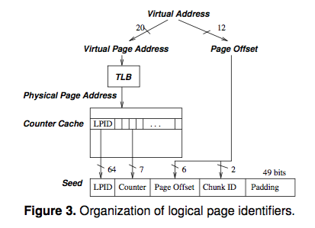
Address Independent Seed Encryption
For each chunk in the memory, its seed is the concatenation of:
  a Logical Page IDentifier (LPID)
  the page offset of the chunk's block
  the block's counter value
  the chunk id.

Slide 31
Memory Integrity Verification
Replay attacks for simply computing MAC
Merkle tree verification
  Keeps hierarchical MACs organized as a tree
  The root of the tree is stored on-chip
  Verification by checking chain of MAC values up to the root MAC

Slide 32
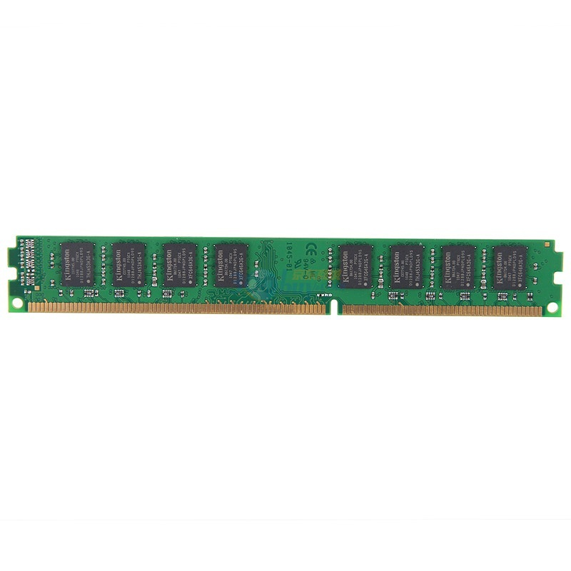
Data Privacy: AISE ^{[Rogers, Micro'07]}
Address
Data Cache
Counter Cache
Data (PlainText)
Counter
Encrypt
XOR
PAD
VM-Key
Secure Processor
Data (CypherText)
Counters
Notes:
AISE is short for address independent seed encryption. It is a technology for data encryption. The main idea is that instead of encrypt/decrypt the data directly, the processor encrypt counters into pad, and then XOR the pad with data for encryption and decryption. Meanwhile, there is a dedicated cache on-chip for the counters to improvement the performance.

Slide 33
Merkel Tree for Data Integrity
Secure Processor
Root
Data (CypherText)
Counters
Hash

Slide 34
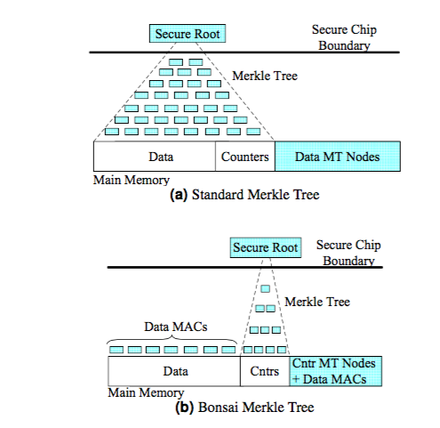
Bonsai Merkle Trees
Each block is protected by its own MAC, computed using a keyed hashing function (e.g. HMAC based on SHA-1),
The block's MAC includes the counter value and address of the block, and
The integrity of all counter values is guaranteed.

Slide 35
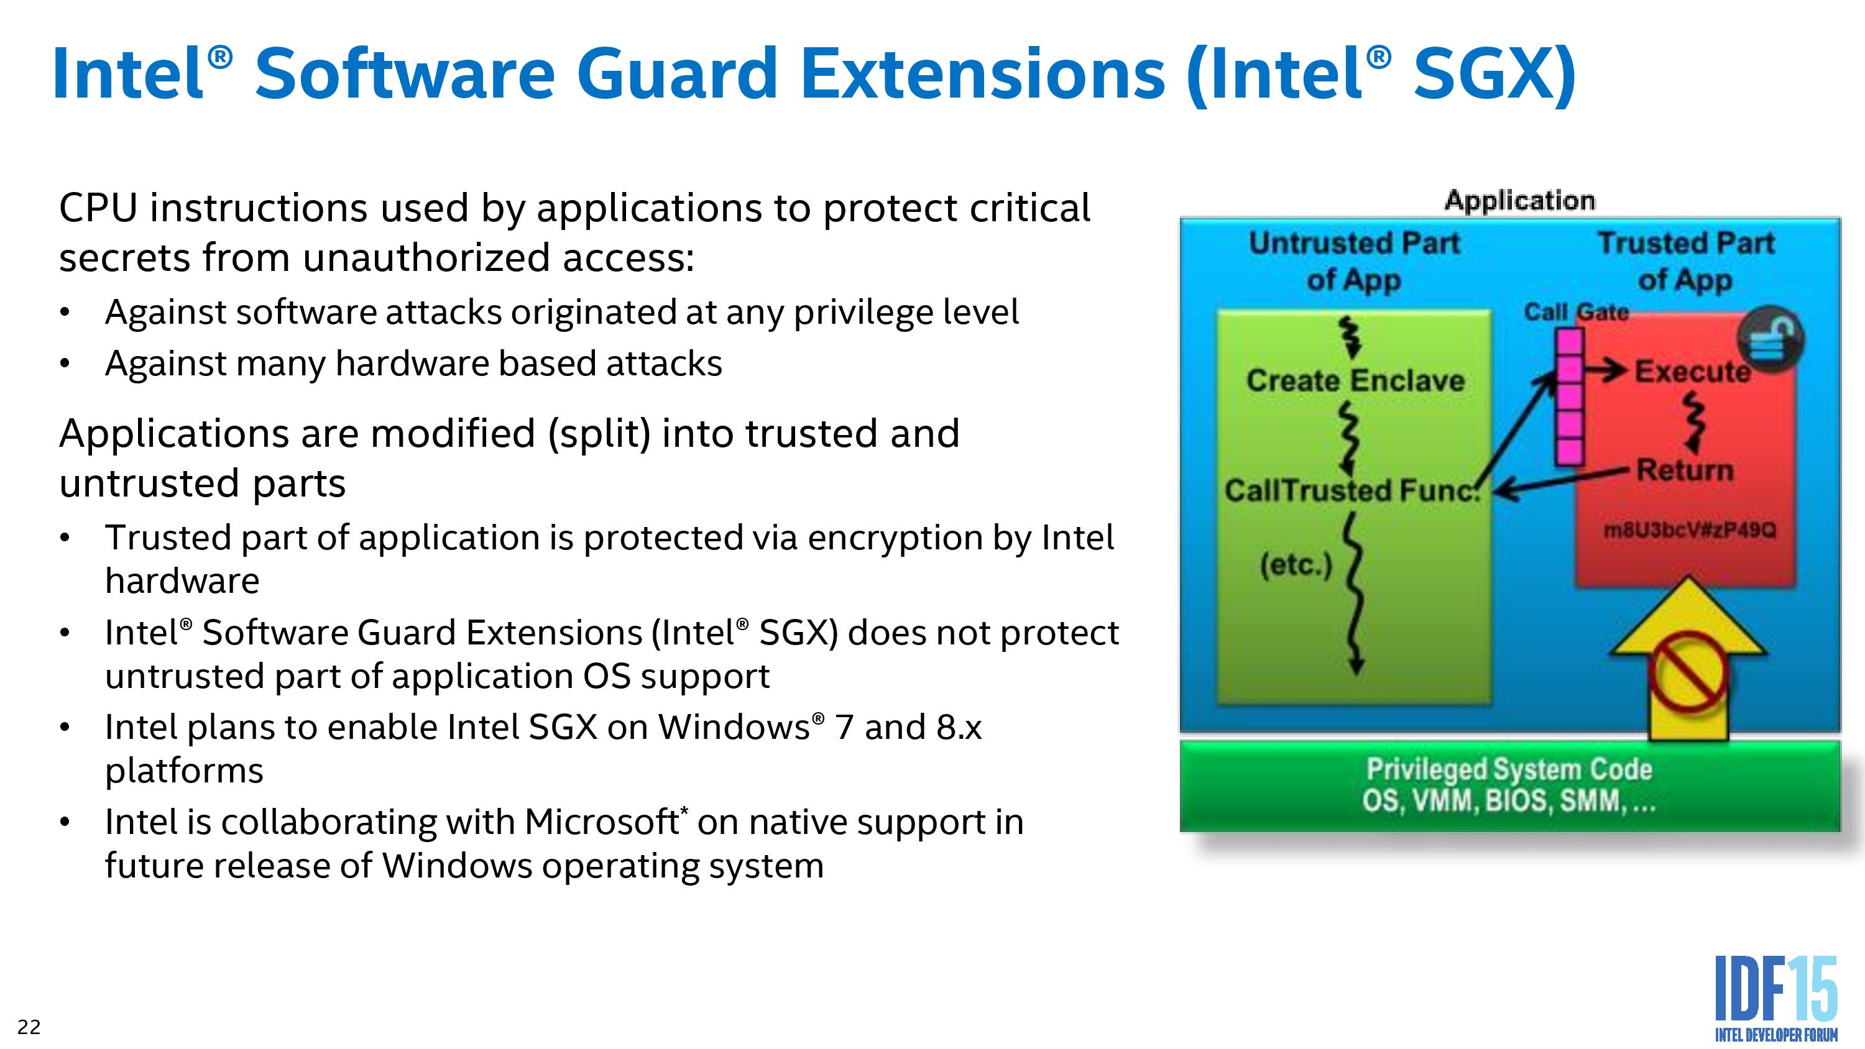

Slide 36
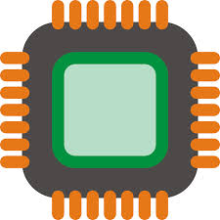

SGX : Isolated Execution
System Memory
CPU Package
Enclave
Access from
OS/VMM
Memory
Encryption
Engine (MEE)
Encrypted
code/data
Snooping
Application keeps its data/code inside the “enclave”
  Smallest attack surface by reducing TCB (App + processor)
  Protect app's secret from untrusted privilege software (e.g., OS, VMM)
Notes:
SGX allows part of application code to run in isolation inside an enclave. The enclave region of the main memory is encrypted. The content is only decrypted inside the CPU package using processor specific keys. Thus, even if a malicious adversary has full control over the hardware, it cannot access/modify the enclave. Also, the enclave is protected from other software running in the host, including the OS and hypervisor. In summary, the TCB is the CPU package and the application code running inside and enclave.

Slide 37
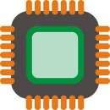



SGX : Remote Attestation
Remote platform
Host platform
Hash
1. Request
2. Calculate
MAC
Target Enclave
Challenger Enclave
CMAC
3. Send MAC
SGX CPU
SGX CPU
Quoting Enclave
4. Verify
6. Send signature
5. Sign with group key [EPID]
Attest an application on remote platform
Check the identity of enclave (hash of code/data pages)
Can establish a “secure channel” between enclaves
Notes:
SGX also support remote attestation. So an enclave program running on a host makes a remote attestation request. The remote platform creates a hash of the enclave or measurement. Then it passes this info to a specially purposed enclave who signs this with a group key. As part of the remote attestation, one can also exchange information, this is often used for Diffie-Hellman key exchange to bootstrap a secure channel between two enclaves.

Slide 38
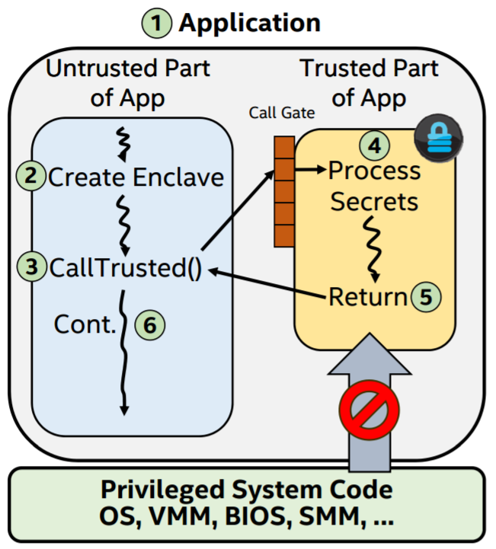
SGX Execution Flow
App built with trusted and untrusted parts
App runs & creates the enclave which is placed in trusted memory
Trusted function is called, execution transitioned to the enclave
Enclave sees all process data in clear; external access to enclave data is denied
Trusted function returns; enclave data remains in trusted memory
Application continues normal execution

Slide 39
Software Architectures of SGX
LibOS
Container
Application
Code Snippet
APP
APP
APP
APP trusted part
LibC interface
APP untrusted part
LibOS
LibC
Libc
Libc
OS
OS
OS
Virtual Machine
Virtual Machine
Virtual Machine
Virtual Machine
Hypervisor
Hypervisor
Hypervisor
Hypervisor
 | Compatibility | TCB Size | Ocall Num | Attack Surface | Protect OS
LibOS | Part | Large | Few | Small | ✔
Container | ✔ | Mid | Mid | Mid | ✘
Application | ✔ | Mid | Many | Large | ✘
Code Snippet | ✘ | Small | Few | Small | ✘

Slide 40
Still A Long Way to Go...

Slide 41
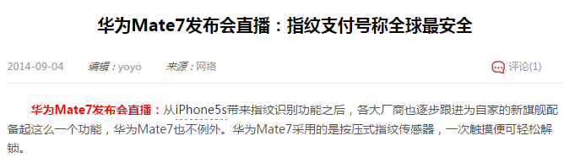
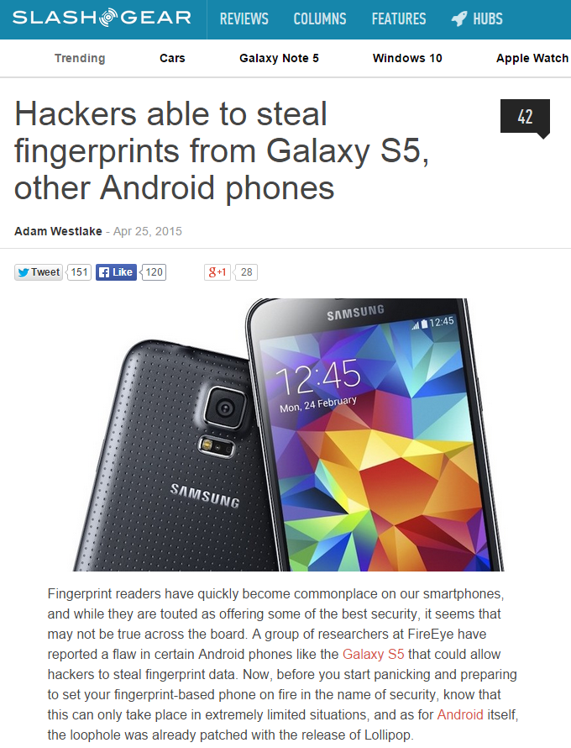
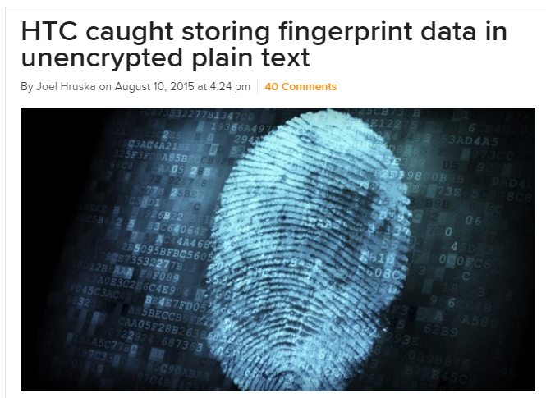

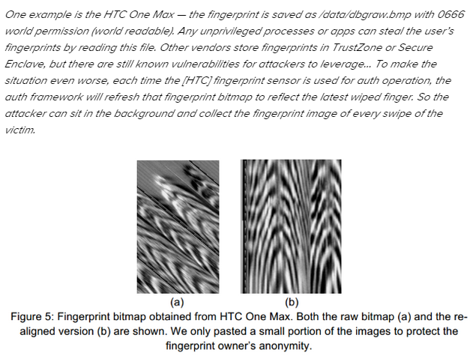
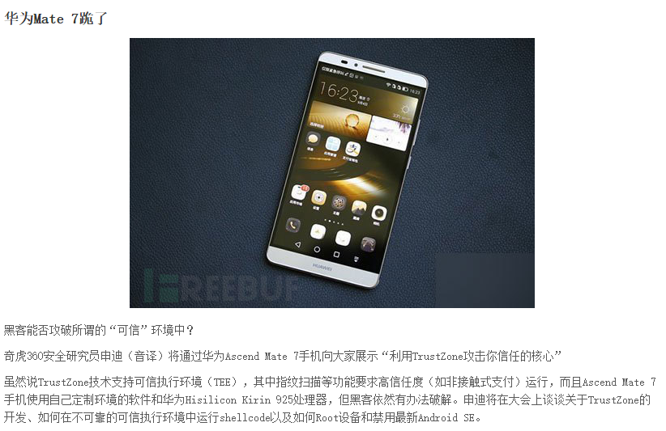
More and More TEE Vulnerabilities
http://www.extremetech.com/mobile/211985-htc-caught-storing-fingerprint-data-in-unencrypted-plain-text

Slide 42

CVE Example: The Boomerang Attack
Boomerang attack
  A time service running in the secure world
    Writing current time to a memory address (as parameter)
  The bug: no check on the address → arbitrary memory writes to REE
    Recall that TEE has higher privilege than REE
    Similar bugs exist in QualComm, Trustonic, SierrawareTEE, Huawei, OP-TEE
Deprivileged TEEs are needed
[NDSS'17] BOOMERANG: Exploiting the Semantic Gap in Trusted Execution Environments
Notes:
Let's show one example: the boomerang attack on 2016 and published on 2017.
In this example, a time service running in the secure world, which will write current time to a memory address which is passed to the service routine as a parameter. The bug, as many bugs, is that the routine forgets to check the range of the address.
Recall that the TEE has highest privilege, it can write to any memory address of the system with the value of current time, which can also be controlled.
Similar bugs are found in various TEE OS.
Thus, we argue that TEE should be deprivileged, otherwise a breached TEE may do arbitrary writing.

Slide 43
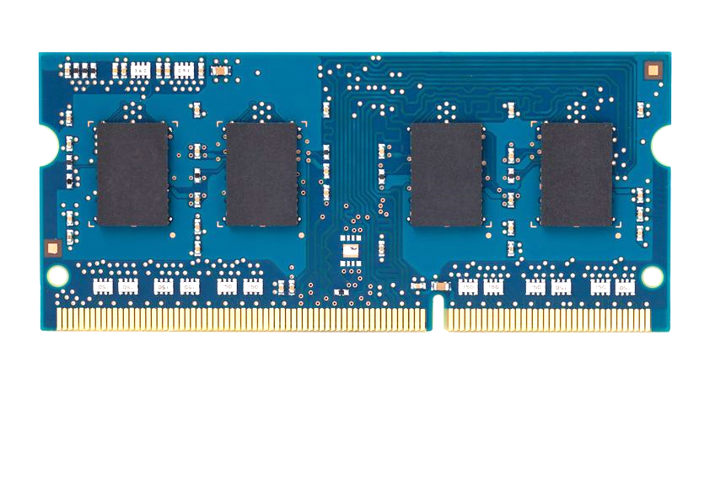
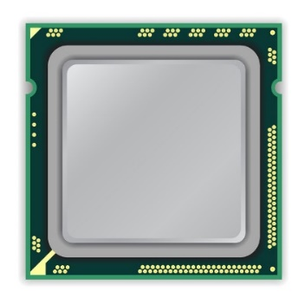
How to Induce Errors
x86 CPU
DRAM Module
DDR3
Avoid cache hits
  Flush X from cache
Avoid row hits to X
  Read Y in another row
111111111
X
111111111
111111111
111111111
Y
111111111
111111111
Notes:
This is the setup of the system where we induce disturbance errors. It has an x86 processor connected to a DRAM module, which is initially populated with a known data-pattern – in this case, all ‘1’s. Our goal, is to construct a program that repeatedly toggles the row at address X.
However, this cannot be achieved just by issuing many loads to address X. This is because of two reasons. First, cache hits in the processor prevent the load from reaching DRAM. But we can avoid this by flushing X from the cache. Second, when there are consecutive accesses to the same row, the processor keeps the row open without closing it. But we can avoid this by interleaving accesses to two different rows: X and Y.

Slide 44
How to Induce Errors
x86 CPU
DRAM Module
DDR3
loop:
mov (X), %eax
mov (Y), %ebx
clflush (X)
clflush (Y)
mfence
jmp loop
001110111
111111111
X
111111111
1111
111111111
101111101
110001011
111111111
Y
1111
111111111
011011110
111111111
Notes:
This is the assembly code that behaves precisely in the manner that I just described. It first opens row X and fetches a cacheline into the processor. But since the next access is to a different row, the processor is forced to close row X before opening row Y. And from row Y, another cacheline is fetched. Subsequently, the two flush instructions evict the cachelines from the processor. Each iteration of the code toggles the two rows X and Y, and after many iterations, many errors appear in adjacent rows.

Slide 45


Rowhammer
Row Buffer
Row 1
0
1
1
1
Row 2
Row 3
Row 4

Slide 46
Rowhammer
Row Buffer
Row 1
0
1
1
1
Row 2
Row 3
Row 4

Slide 47
Rowhammer
Row Buffer
Row 1
0
0
1
1
Row 2
Row 3
Row 4

Slide 48
Number of Disturbance Errors
In a more controlled environment, we can induce as many as ten million disturbance errors
Disturbance errors are a serious reliability issue
CPU Architecture | Errors | Access-Rate
Intel Haswell (2013) | 22.9K | 12.3M/sec
Intel Ivy Bridge (2012) | 20.7K | 11.7M/sec
Intel Sandy Bridge (2011) | 16.1K | 11.6M/sec
AMD Piledriver (2012) | 59 | 6.1M/sec
Notes:
When we executed the code on four different processors, all four of them yielded errors. Intel Haswell has the most errors, at 23 thousand, because it has the highest rate of accessing DRAM.
Later on, I’ll show that we can induce as many as ten million disturbance errors in a more controlled environment.
From this, we conclude that disturbance errors are a serious reliability issue.

Slide 49
Meltdown
    Break user/kernel isolation
Allow attacker to read arbitrary kernel data
    Hardware bug in architecture
Hard to be fixed by micro-code patch
    Exist in almost all Intel CPUs produced in past 20 years

Slide 50


Meltdown
key = 0x01
Mapped with kernel privilege in page table
Kernel
User
Access key
Permission Error!

Slide 51

Meltdown
key = 0x01
Mapped with kernel privilege in page table
Kernel
User
Meltdown
Can access key!

Slide 52



Meltdown
CPU
Instruction
Effect
Cache
Memory
key = 0x01
Kernel
User
Meltdown

Slide 53
Meltdown
CPU
Instruction
Effect
Permission Error!
1
Load key, %rax
%rax = 1
Reorder
Execution
Load buf[%rax], %rbx
Access buf[1]
2
Cache
Memory
key = 0x01
Kernel
Key = 1
… | buf[0] | buf[1] | buf[2] | … | buf[n] | …
User
Meltdown
buf
(Attack buffer)

Slide 54
Meltdown
CPU
Instruction
Effect
Permission Error!
1
Load key, %rax
%rax = 1
Reorder
Execution
Load buf[%rax], %rbx
Access buf[1]
2
Rollback status
w/o cache status!
Exception
3
Cache
Memory
key = 0x01
Kernel
2
Key = 1
buf[1]
… | buf[0] | buf[1] | buf[2] | … | buf[n] | …
2
User
Access
buf[1]
Fill buf[1]
to cache
Meltdown
buf
(Attack buffer)

Slide 55
Meltdown
CPU
Instruction
Effect
Permission Error!
1
Load key, %rax
%rax = 1
Attacker finds that buf[1] is in the cache, so that key equals to 1!
Reorder
Execution
Load buf[%rax], %rbx
Access buf[1]
2
Rollback status
w/o cache status!
Exception
3
Cache
Memory
key = 0x01
Kernel
2
Key = 1
buf[1]
… | buf[0] | buf[1] | buf[2] | … | buf[n] | …
2
User
Access
buf[1]
Fill buf[1]
to cache
Meltdown
buf
(Attack buffer)

Slide 56
Existing Solution
    KPTI (Kernel Page Table Isolation)
Two page tables for user and kernel space
  User page table only maps user space
  Kernel page table maps both user and kernel space
Switch the page table during user/kernel switching
  Add latency to syscalls, signal handler,…
Not suitable for the cloud environment

Slide 57
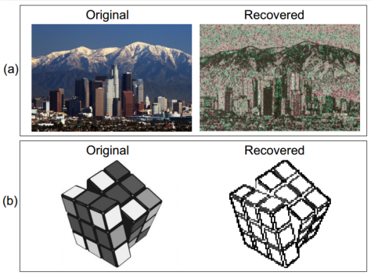
SGX's Vulnerabilities
Side channel attack
  Malicious OS still controls page fault handler
  If know the photo processing algorithm, can get the image by monitoring page fault
  Not 100% accurate, but still good enough

Slide 58
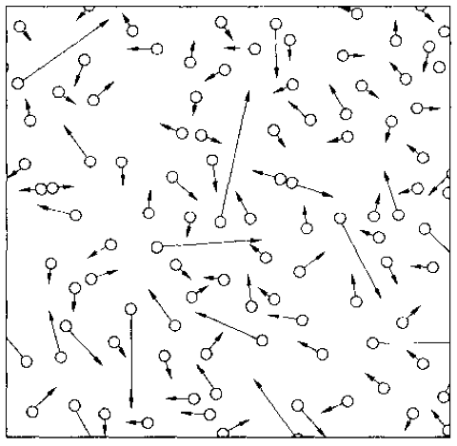
Summary
Complexity is inevitable
  From one node to multiple nodes
  From hundreds of LoC to millions of LoC
  From reliable environment to unreliable environment
  From trusted components to untrusted components
New properties from system's perspective
  All-or-nothing, before-or-after, isolation, throughput, latency, utilization, fault tolerance, security, scalability, TCB...

